Slide 1

Nowości z konferencji Microsoft Build 2016
Paweł Troka & Krzysztof Pastuszak

Slide 2
Plan prezentacji
C# 7.0 i przyszłość C# (troszeczkę szczegółów i idea)
Bash dla Windowsa (chociaż zdecydowanie mniej o tym powiemy - bo i tak było o tym głośno)
Project Centennial (tu bym chciał troszeczkę więcej niż przegląd)
Przegląd nowości platformy .NET / .NET Core (niewiele, bardziej idea "One .NET Framework for One Microsoft")
Xamarin Cross-Platform Mobile (przegląd ale całkiem szczegółowy)
Universal App Model / Universal Windows Platform + Continuum (bardzo krótko, bo bardziej o idei niż o szczegółach)
Visual Studio "15" - przyszłość Visual Studio (tylko kilka faktów o nowościach w nadchodzącym Visual Studio)
Visual Studio 2015 Extensibility (tylko opcjonalnie, chociaż prezentacja z Build zrobiła na mnie duże wrażenie: https://channel9.msdn.com/Events/Build/2016/B886)

Slide 3
C# 7.0 and beyond

Slide 4
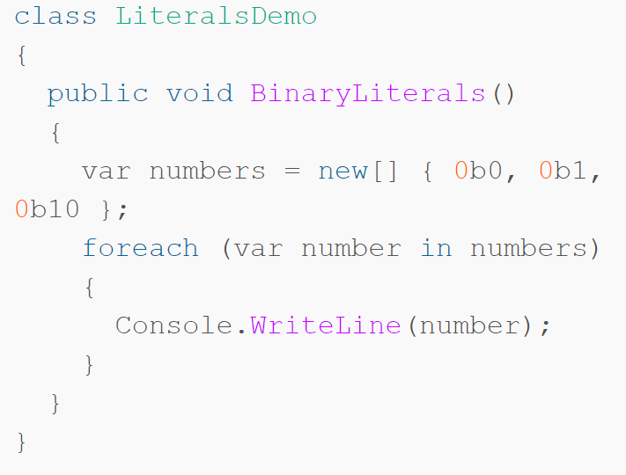
Binary literals

Slide 5
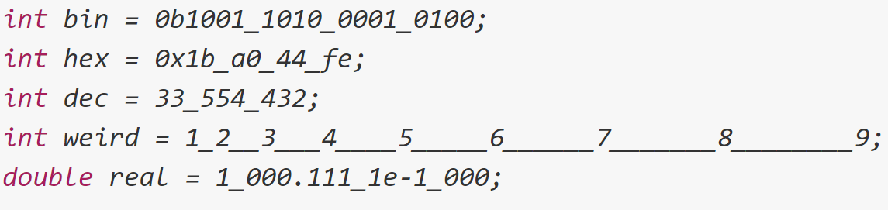
Digit separators

Slide 6
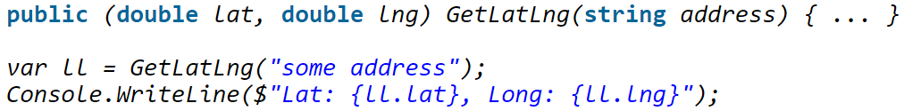
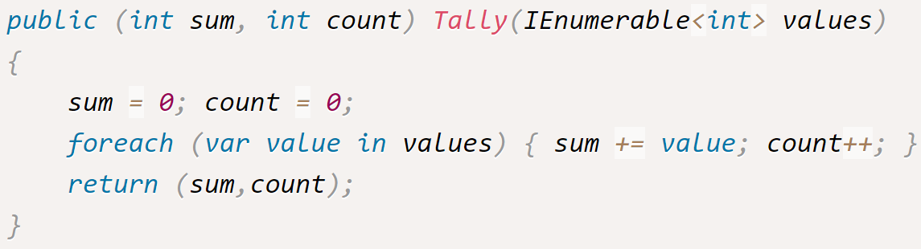
Tuples

Slide 7
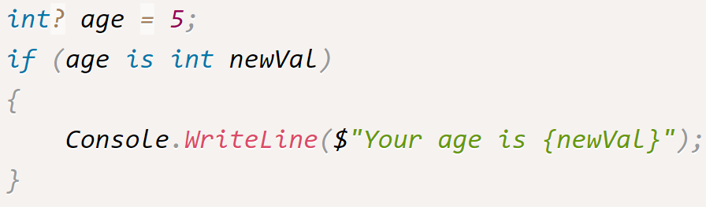
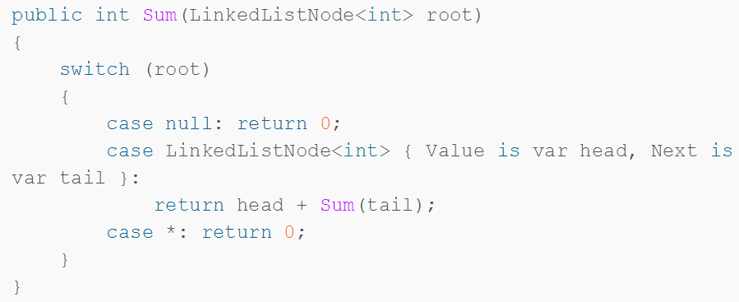
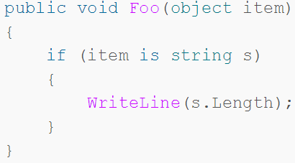
Pattern Matching

Slide 8
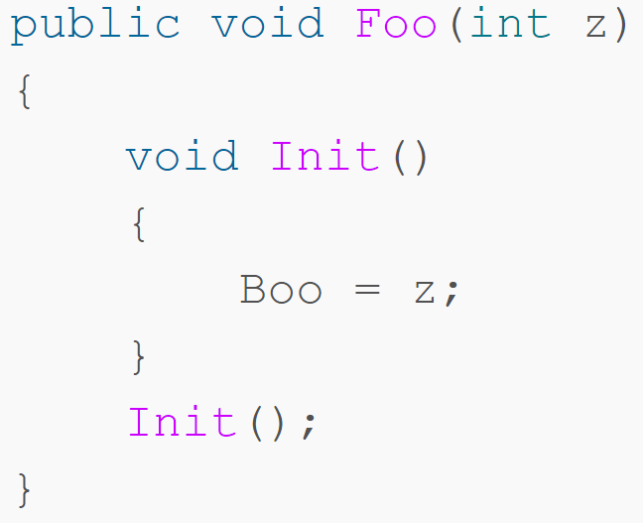
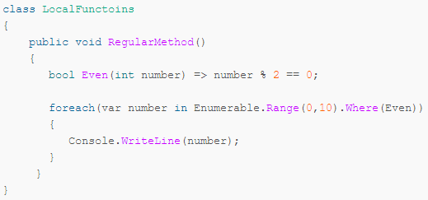
Local functions

Slide 9
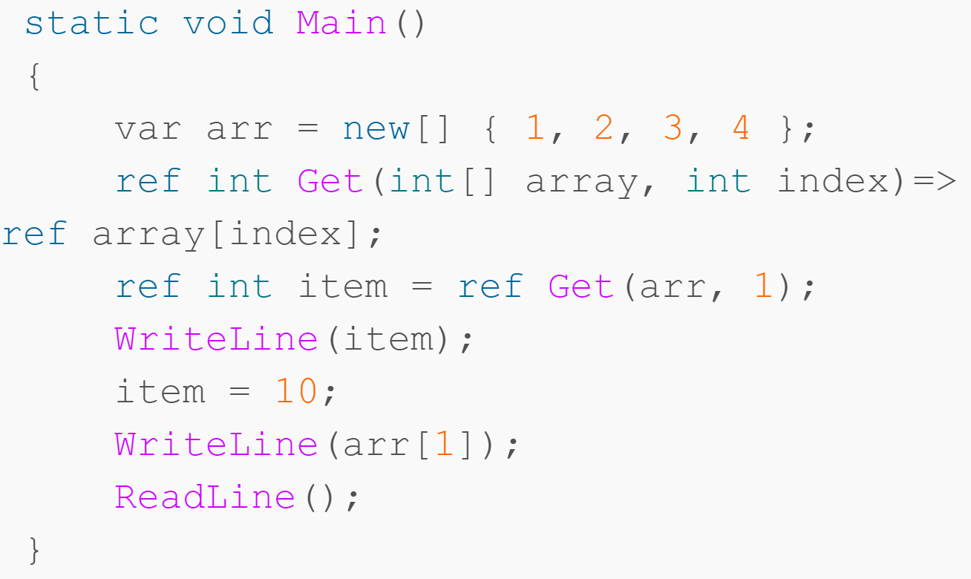
Ref returns and locals

Slide 10
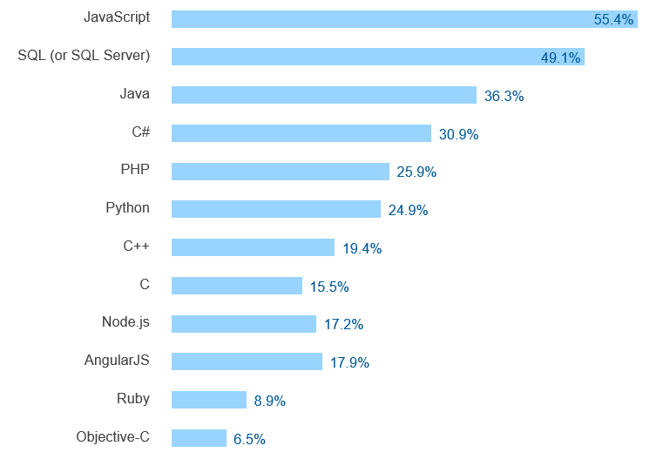
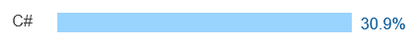
Most popular technologies
http://stackoverflow.com/research/developer-survey-2016#technology-most-popular-technologies

Slide 11
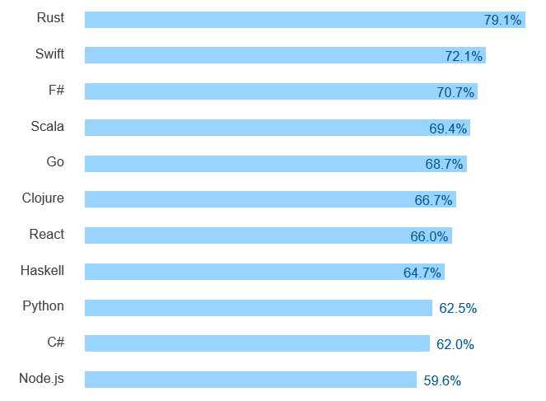
Most loved technologies
http://stackoverflow.com/research/developer-survey-2016#technology-most-loved-dreaded-and-wanted

Slide 12
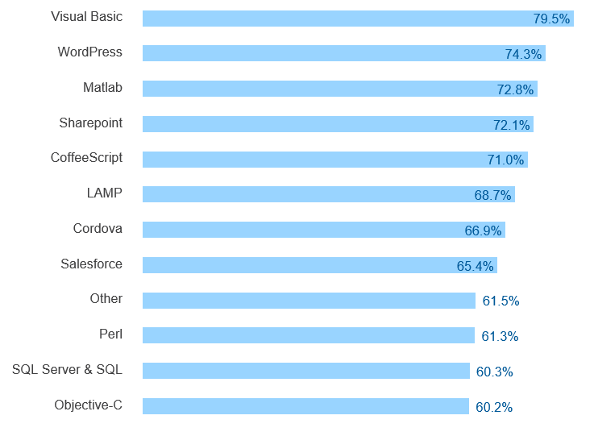
Most dreaded technologies
http://stackoverflow.com/research/developer-survey-2016#technology-most-loved-dreaded-and-wanted

Slide 13
Changing our tune…
Run on Windows
.NET as system component
Run on VM (CLR)
Black box compilers
Edit in Visual Studio
Proprietary
Run everywhere
Deploy with app
Compile to native
Open compiler APIs
Use your favorite editor
Open source

Slide 14
Roslyn
C# and VB language engine for all the things!
All the IDEs and editors
All the linters and analysis tools
All the fixing and refactoring and code generation tools
All the scripting and all the REPLs
There should only need to be
one code base in the world
for understanding C#

Slide 15
The Future of C#
C# 7
VS Code integration
Improving the “inner loop”

Slide 16
Maybe: Records
class Person(string First, string Last);
class Person : IEquatable<Person>
{
public string First { get; }
public string Last { get; }
public Person(string First, string Last) { this.First = First; this.Last = Last; }
public (string First, string Last) Deconstruct() => (First, Last);
public bool Equals(Person other)
=> other != null && First == other.First && Last == other.Last;
public override bool Equals(object obj) => obj is Person other ? Equals(other) : false;
public override int GetHashCode() => GreatHashFunction(First, Last);
…
}

Slide 17
Maybe: Creating immutable objects
var p1 = new Point { X = 3, Y = 7 };
var p2 = p1 with { X = -p1.X };

Slide 18
Bash for Windows

Slide 19
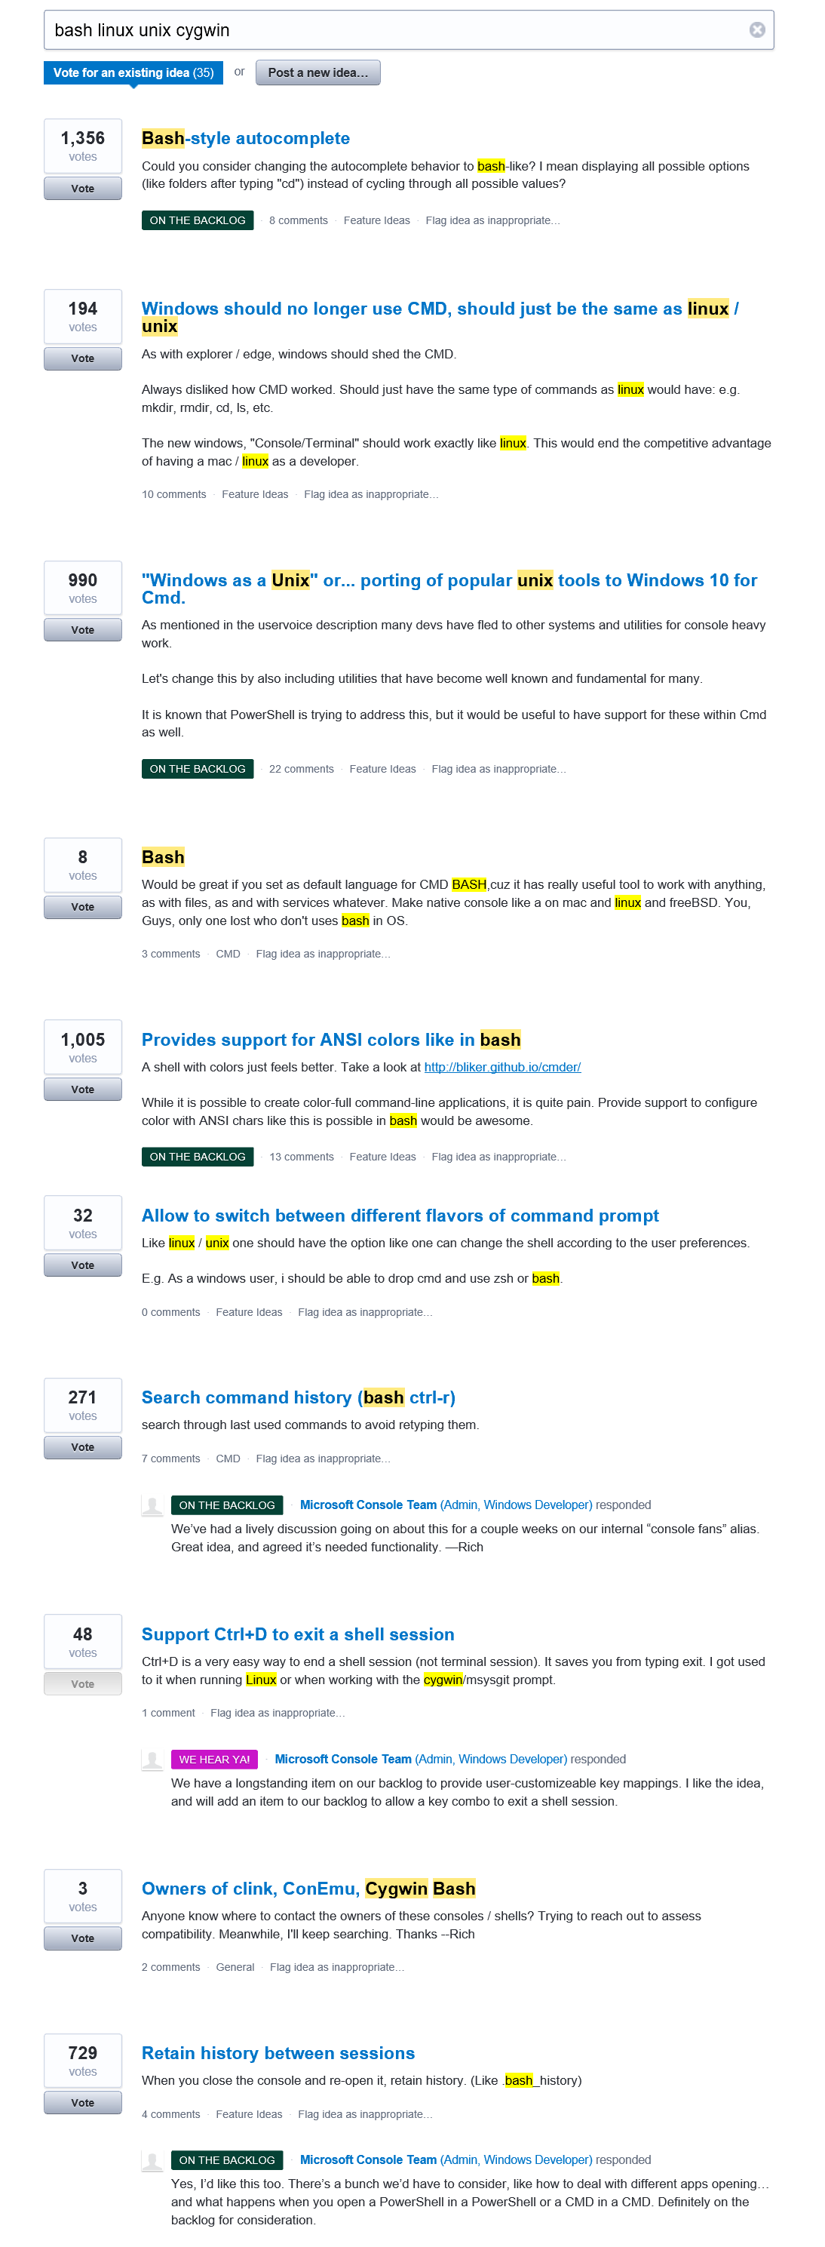
We hear ya!
During Windows 10 we started a conversation about the Windows command-line
https://wpdev.uservoice.com/forums/266908-command-prompt/filters/top
THANK YOU for your ideas & asks ☺
Two central themes emerged
Improve the Windows Console
Bring Unix/Linux tools to Windows
Bash, ssh, grep, sed, awk, etc.
Better support platforms used by OSS projects (esp. Ruby, Python, etc.)
Lots more coming soon on this ☺

Slide 20
*NIX Tools on Windows?
Why?
Homogeneity is sooo 1998!
Windows & *NIX are more prevalent than ever before
Many open-source projects depend on *NIX features
How to bring *NIX tools & features to Windows?
Considered LOTS of options
Wanted a legitimate, comprehensive, solid, stable, long-term solution…

Slide 21
The solution?
Integrate UserMode Linux & its tools into Windows
Run Linux on Windows
Yes! Really!!
No VM’s – REAL Linux. On Windows. In Windows. Together!
Introducing
Windows Subsystem for Linux
Ubuntu UserMode on Windows through partnership with Canonical

Slide 22
User-mode
Ubuntu
Bash, git, Ruby, etc.
Native Linux Bash, git and Ruby binaries
In Ubuntu
On Windows Subsystem for Linux
A new feature of the Windows kernel
Exposes a Linux-compatible syscall layer
Windows Kernel
Kernel
Windows Subsystem for Linux
Syscalls
read
write
open
fork
…

Slide 23
Project Centennial
Desktop App Converter

Slide 24
What is Project Centennial?
Improving the Windows platform for all developers
Convert desktop apps to the Universal Windows deployment technology
Keep your current Win32/.NET code running
Code targets Windows 10 and Windows 7 PCs
Add Universal Windows components over time
Monetize via Windows Store or other distribution of choice

Slide 25
Developer Workflow
Desktop App Converter
Converts existing desktop installer
Results in a packaged app with UWP manifest
Test, Update and Evolve
Make compatible code changes that go into both MSI and app package
Evolve app package to take advantage of the Universal Windows Platform
Publish and Distribute
Distribute the app package via sideloading, MDM or the Windows Store*
MSI
AppX
*Pending availability

Slide 26
Step 0 – Win32 Desktop App
Classic Desktop Application
Win32/.NET code base
MSI installer
Runs in a desktop process
Classic Windows App

Slide 27
Step 1 – Convert the App
Universal App Package
Immediate Benefits:
Modern deployment technology for all apps
Seamless updates, clean uninstall
Monetize via Windows Store or other distribution of choice
Runs your current code
Small amount of code changes needed (if any)
Classic Windows App

Slide 28
How does it work?
Deployment
Uses Universal Windows Platform deployment stack
Extensions for required Win32 extension points
Shell extensions (e.g. file type associations)
Solving “DLL Hell” and “Registry Bloat”
Registry redirection / merging
Filesystem redirection / merging
Write redirect for certain directories
Same code will continue work on Windows 7, 8, etc.

Slide 29
Bridge to the Universal Windows Platform
At this point your app already has
Modern deployment
Activation via Tiles, file types or URI protocols
App Identity → access to more UWP API surface
UWP App Model
What else does this enable?
→ Short answer: Anything a UWP app can do !

Slide 30
Step 2 – Call UWP APIs
Universal App Package
Feature Examples:
Live Tile support
Actionable Notifications
Cortana
etc.
Classic Windows App
Universal Windows API

Slide 31
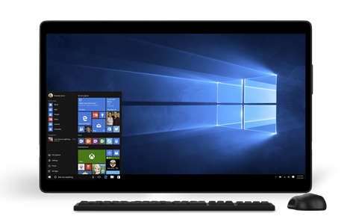
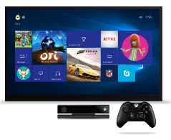
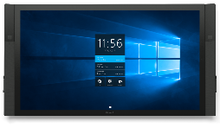

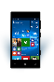
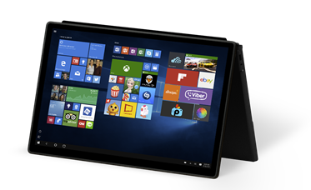
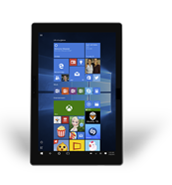
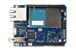
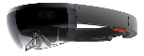
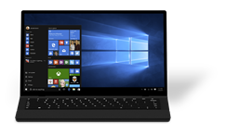
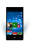
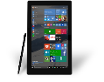
Continue the Migration to UWP
Do anything a UWP app can do
Take advantage of more UWP APIs
Take advantage of app services, background tasks & triggers
Migrate UI to XAML
Devices +IoT
Holographic
PC
Mobile
Xbox
Surface Hub
Adaptive User Interface
Natural User Inputs
One SDK + Tooling
One Store + One Dev Center
Cloud Services
Configuration
Security
Management
Updates

Slide 32
Step 3 – Add a UWP Component
Universal App Package
Feature Examples:
XAML UI front end
Background tasks
File Picker UI
Runs in the App Container
Communication via AppService
Classic Windows App
Universal Windows App

Slide 33
Desktop & App Container processes
Current code running in Desktop process
UWP app code runs in App Container
Activate Desktop process from App Container and vice-versa
Inter process communication (via AppService)
Desktop Process
Activate
App Container Process
Activate
Communicate

Slide 34
Step 4 – Migrate code to UWP
Universal App Package
Move UWP Compatible code/components into the App Container
Classic Windows App
Universal Windows App

Slide 35
Step 5 – Fully UWP
Universal App Package
Move remaining code into the App Container
Run everywhere
PC
Mobile
Xbox One
HoloLens
etc.
Universal Windows App

Slide 36
Complete Migration to UWP
Clean up/replace non-compliant code
More Win32 APIs supported in the AppContainer
Move remaining code into the App Container
Run everywhere (PC, phone, Xbox One, HoloLens, etc.)

Slide 37
Project Centennial is a bridge from Classic Windows Applications to Universal Windows Apps

Slide 38
Why Project C
Huge ecosystem of CWAs
No CWA app model
MSI is brittle
Your apps in the Store
Gradually move to UWAs

Slide 39
Great user experience
Single-click acquisition
Automatic updates
Highly reliable
User feels confident

Slide 40
Using Project C
Convert existing CWA
Test / update
Publish to the store

Slide 41
How does it work

Slide 42


Conversion
Convert
Test
Update
MSI
AppX

Slide 43
Namespace management
Filesystem merging
Registry merging
Registry redirection
AppData redirection

Slide 44
Namespace merging
Merged View
App Namespace
System Namespace
C:\Windows\System
\advapi.dll
\kernel32.dll
\msvcrt.dll
\shell32.dll
C:\Windows\System
\msvcrt.dll
C:\Windows\System
\advapi.dll
\kernel32.dll
\shell32.dll
App

Slide 45
Namespace write redirection
App Namespace
System Namespace
AppData & Registry
Documents, etc.
App

Slide 46
Full trust activations
Live tiles
File type associations
Uri schemes
App Container ←→ Full Trust

Slide 47
Activation & Communication
Full Trust Process
Activate
Communicate
Activate
App Container Process

Slide 48
What else can you do
Anything a UWA can do
Seriously, anything
Seriously

Slide 49
Moving to UWA
Start moving UI to Xaml
Clean up non-MSDK code
Remove full trust code
Run everywhere

Slide 50

Summary
Project C is a bridge to UWAs
Converts your apps to AppX
Uses namespace merging
Let’s you start adding UWA features

Slide 51
.NET Nowości

Slide 52
Exciting times ahead for .NET
Multi-purpose, comprehensive framework for desktop and web applications
Modern DEVICE EXPERIENCES
Universal Windows platform
Unified development across Windows devices
XAMARIN
Extend your reach to any device with .NET
.NET FRAMEWORK
Modern CLOUD EXPERIENCES
.NET CORE
Cross-platform, high performance .NET
ASP.NET Core
Cloud optimized framework for micro services

Slide 53
.NET today—the family gets bigger
.NET CORE
.NET FRAMEWORK
XAMARIN
Platform for .NET applications on Windows
Cross-platform and open source Mono-based runtime for iOS, OS X, and Android devices
Cross-platform and open source framework optimized for modern app needs and developer workflows
Distributed with
Windows
Distributed with app
Distributed with app

Slide 54
.NET today—app models and libraries
.NET FRAMEWORK
.NET CORE
XAMARIN
APP
MODELS
WPF
Windows Forms
UWP
iOS
Android
ASP.NET
ASP.NET Core
OS X
*
BASE
LIBRARIES
Base Class Library
Core Library
Mono Class Library
COMMON INFRASTRUCTURE
Compilers
Languages
Runtime components

Slide 55
.NET today—reusing code
.NET FRAMEWORK
.NET CORE
XAMARIN
APP
MODELS
My code
BASE
LIBRARIES
Implementation 3
Reference implementation
Implementation 2
Implementation 1
PCL reference assemblies
COMMON INFRASTRUCTURE
Compilers
Languages
Runtime components

Slide 56
.NET today—challenges
Developers
Key API’s are not present on all platforms
Different implementations on each platform
Need to target a small common denominator to reuse code
Need to master 3+1 base class libraries
Platforms
Need implementations of new capabilities on each platform
Need to align with different ship cycles (e.g., Windows for .NET Framework)

Slide 57
.NET tomorrow
.NET FRAMEWORK
.NET CORE
XAMARIN
WPF
Windows Forms
UWP
iOS
Android
ASP.NET
ASP.NET Core
OS X
*
.NET STANDARD LIBRARY
One library to rule them all
COMMON INFRASTRUCTURE
Compilers
Languages
Runtime components

Slide 58
.NET tomorrow—reusing code
.NET FRAMEWORK
.NET CORE
XAMARIN
Reference implementations
Full implementations
My code
COMMON INFRASTRUCTURE
Compilers
Languages
Runtime components

Slide 59
.NET standard libraries—advantages
Developers
Same API’s available on all platforms
Master one library not a platform
Big surface area—no small common denominator
Platforms
.NET Standard can grow without updating platforms
Fast innovation on libraries, common infrastructure, and tools

Slide 60
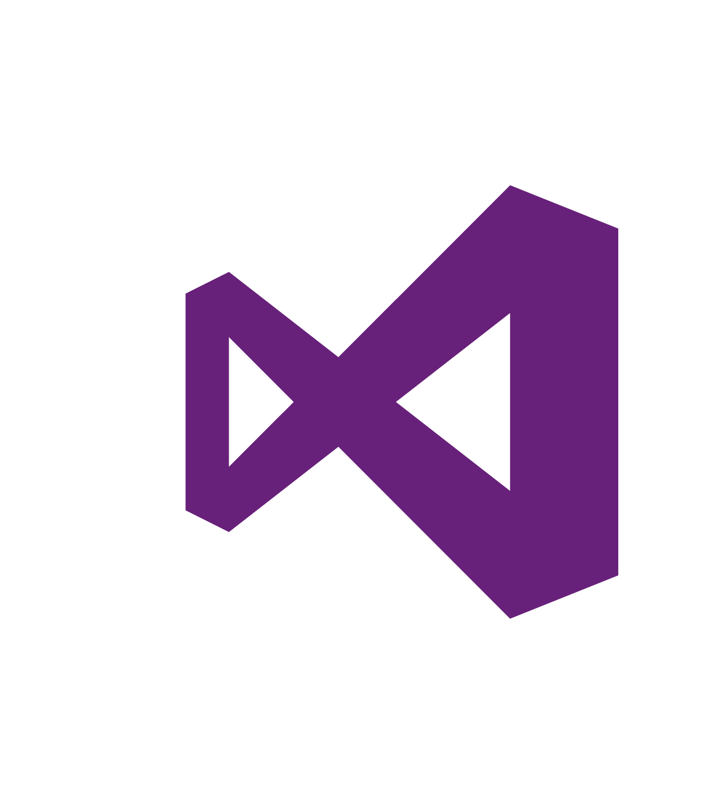
.NET future innovation
App Model Innovation
.NET FRAMEWORK
.NET CORE
XAMARIN
TOOLS
WPF
Windows Forms
UWP
iOS
Android
ASP.NET
ASP.NET Core
OS X
*
Visual Studio
.NET Innovation
.NET STANDARD LIBRARY
One library to rule them all
Visual Studio
Code
COMMON INFRASTRUCTURE
Compilers
Languages
Runtime components

Slide 61

Developed in the open
Fully open development process
Open Source
Open to community contributions
Open process: roadmap, design docs, standups…
+ Great community momentum
175 repositories
24,061 forks
4,297 contributors
http://dotnet.github.io
= Amazing results
1.15 Million requests/second!
New performance record for .NET Core
6x node.js performance
~40% performance gains contributed by community

Slide 62




.NET Compiler Platform ("Roslyn")
MVVM Light Toolkit
MSBuild
ASP.NET MVC
IdentityManager
ASP.NET Core
MEF
.NET Core
.NET SDK for Hadoop
.NET Micro Framework
Kudu
Cecil
Mimekit
Mono
Mailkit
Xamarin.Auth
Umbraco
Open Live Writer
NuGet
WorldWide Telescope
Couchbase Lite for .NET
ASP.NET Web Pages
Microsoft Azure SDK for .NET
ASP.NET SignalR
WCF
Openness
Community
Rapid innovation
LLILC
Xamarin SDK
Entity Framework
Open XML SDK
IdentityServer
Microsoft Azure WebJobs SDK
Microsoft Web Protection Library
OWIN Authentication Middleware
Orchard CMS
ProtoBuild
ASP.NET Web API
System.Drawing
Orleans
ASP.NET AJAX Control Toolkit
Prism
Xamarin.Mobile
Salesforce Toolkits for .NET
Protection
Practices
Visibility
Support
Licenses
Copyrights
Trademarks
Patents
Mentorship
Governance
Feedback
Co-ordination
Media
Branding
Events
Hosting
Code signing
CLA Management
Swag

Slide 63



Announcing
New .NET Foundation members

Slide 64
.NET Framework
Premier platform for building desktop applications
Cryptography enhancements
WPF improvements like Per Monitor DPI and soft keyboard support
ClickOnce—TLS 1.1/1.2 Support
Tooling advancements in early VS “15” Preview
XAML edit-and-continue for WPF
Coming soon: Desktop to UWP bridge (“Centennial”) will allow you to take your WinForms and WPF apps to the Windows Store
Coming soon: XAML language service updates

Slide 65
Universal Windows Platform
Visual Studio 2015 Update 2 wave of tools
Our most significant update to .NET since Windows 10 RTM (mid-April)
New .NET Native tools with 600+ correctness and performance fixes
New UWP meta-package with fixes in .NET Core libraries
New experiences
Support for HoloLens and Xbox development
Debug installed app packages on HoloLens/Xbox/IoT
Smoother package creation workflow
Visual Studio “15” Preview wave of tools
XAML edit-and-continue
Coming soon: Application analysis for proactive reporting of potential runtime issues

Slide 66
Languages
C#
Highly popular, broadly used, and deeply loved
Keep evolving aggressively but tastefully to address modern developer scenarios
Visual Basic
Same great language you know and love with the power of the .NET platform and the productivity of Visual Studio
F#
Functional-first language, harmonized with .NET
Works with .NET Framework, .NET Core, and Xamarin

Slide 67
Productivity
We want to make the inner loop faster. It is the cycle of code-test-compile-debug
Search, navigate, and debug external code
Find and automatically install NuGet package by symbol
Navigate (F12 and find all references) external code
Debug (step into) it as well!
Code style
Configurable per developer preference
Code that doesn’t meet style preferences is squiggled and fixable

Slide 68
Productivity
FxCop as analyzers
Bad code is squiggled in VS using live analysis as you type (no longer a need to wait for build)
Recommended auto fixes show in light bulb UI and can be fixed at file, project, or solution scope
C# Repl
Right-click in the editor and send a code snippet to be executed in the Interactive Window
Right-click on a project in your Solution Explorer to seed the Interactive Window with your project context

Slide 69
.NET Core
New OSS and x-plat .NET runtime and library
Introducing NET Standard
“.NET Core CLI”—for compiling and publishing apps
Supports app-local, shared framework, and ocker deployment
High performance, including native compilation

Slide 70
ASP.NET Core
ASP.NET Core builds on top of .NET Core
Single framework, for web, services, and microservices
Middle-ware pipeline, enabling you to inject as little or much functionality as needed
Fully integrates with CLI tooling and the shared framework
Takes advantage of .NET Core performance and include a very high performance web server, built on LibUV

Slide 71
.NET Core on Red Hat

Slide 72
Redhat.Developers.com

Slide 73


Slide 74
The Red Hat Developers Program is FREE
it includes Red Hat Enterprise Linux for Development
redhatloves.net

Slide 75
Recap
Great time to be a .NET Developer
With .NET you can build (ANYTHING)
Windows Desktop Applications (Win 7, Win 8, Win 8.1, Win 10+)
Windows Universal Apps (Desktop, Tablet, Mobile)
Server Applications (Windows, Linux)
Device Application (iOS and Android)

Slide 76
Xamarin Cross-Platform

Slide 77
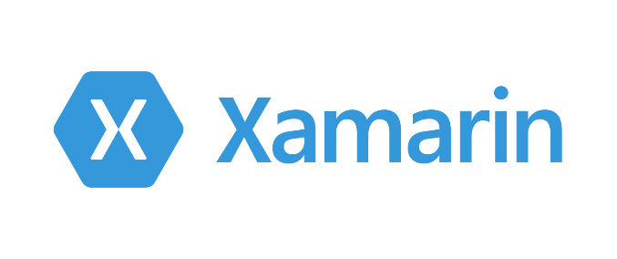

Slide 78
Mobile Agility with Xamarin and .NET
Increase Your Reach
Support customers on every device, everywhere
Delight your Customers
Use the best features available on each platform
Full access and full control of the platform
High Quality Apps
Avoid platform disparity
Do not fix the same bug three times
Lower Development Costs

Slide 79
Open Source .NET Everywhere

Slide 80
Windows APIs
Microsoft.Phone
Microsoft.Networking
Windows.Storage
Windows.Foundation
Microsoft.Devices
System.Net
System
System.IO
System.Linq
System.Xml
System.Data
System.Windows
System.Numerics
System.Core
System.ServiceModel

Slide 81
iOS – 100% API Coverage
MapKit
UIKit
iBeacon
CoreGraphics
CoreMotion
System.Net
System
System.IO
System.Linq
System.Xml
System.Data
System.Windows
System.Numerics
System.Core
System.ServiceModel

Slide 82
Android – 100% API Coverage
Text-to-speech
ActionBar
Printing Framework
Renderscript
NFC
System.Net
System
System.IO
System.Linq
System.Xml
System.Data
System.Windows
System.Numerics
System.Core
System.ServiceModel

Slide 83
Xamarin’s Cross-platform approach
iOS-specific C#
Android-specific C#
Windows-specific C#
Shared C# Logic
Shared C# codebase • 100% native API access • High performance

Slide 84
Sharing Code - Strategies
Shared Projects
Put shared code in a “Shared Project”
Reference the shared project from Android, iOS, Windows, Web
And the source code from the shared project is included.
Very flexible, can use partial classes, very simple, full API access
Portable Class Libraries
For when you are designing code to be consumed by others
Easier to consume by third parties
Limited API access
Existing Components and NuGets
Our libraries support you with either approach

Slide 85
TextToSpeech.Speak(“Hello World”);
AVSpeechSynthesizer
TextToSpeech
SpeechSynthesizer

Slide 86
Plugins for Xamarin
xamarin.com/plugins
Common Mobile API
Speech
Camera
Settings
Connectivity
SMS
Location
Platform Native APIs

Slide 87
Xamarin.Forms slide
iOS-specific C#
Android-specific C#
Windows-specific C#
Shared Xamarin.Forms UI
Shared C# Logic

Slide 88
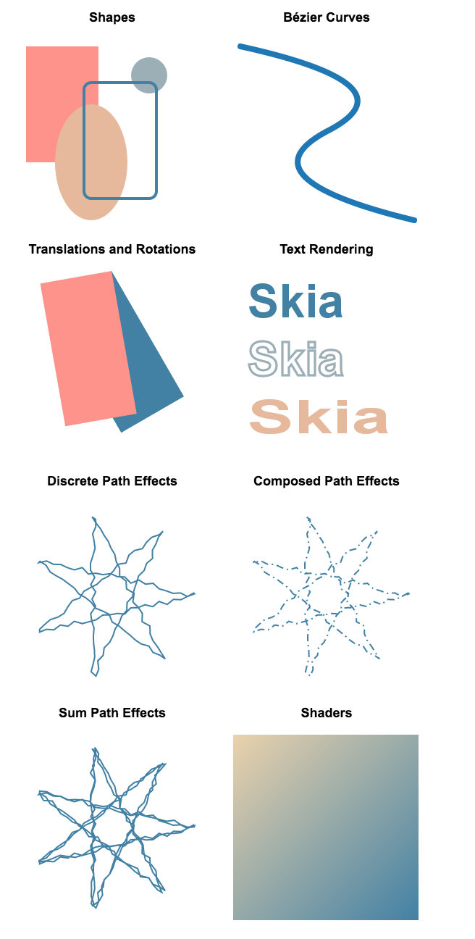

2D Graphics Library
Skia
The 2D graphics engine
Powers Google Chrome and Android.
Cross platform: Android, iOS, Mac, Windows. Coming soon: UWP, tvOS.
Comprehensive
Image loading and saving
Immediate composited rendering mode
GPU accelerated (where available/enabled)
Custom effects and shaders
Actively Developed
Both Skia and the SkiaSharp bindings are in active development
Shapes
Bézier Curves
Translations & Rotations
Text rendering
Discrete Path Effects
Composed Path Effects
Sum Path Effects
Shaders

Slide 89
3D Retained Graphics Engine
Urho
Retained 3D engine
Cross platform: Android, iOS, Mac, Windows. Coming soon: UWP, tvOS.
Comprehensive
3D Scenes
Retained component system
GPU accelerated
Custom effects and shaders
Actively Developed
Both Urho and the UrhoSharp bindings are in active development

Slide 90
Inspector
IDE support to inspect live applications
Monitor your application live
Execute C# code against a running application
Make changes, explore your application
Powered by Roslyn’s C#
Cross Platform
Supports Android, iOS, Mac and Windows

Slide 91
Workbooks
Bringing Interactive C# to the next level
Learn by experimentation
Workbooks are live documents
They contain Markdown text
With embedded C# code
The code executes on demand
And re-executes any code after you make changes

Slide 92
Authoring tests
Unit testing
UI Testing
Test Recorder

Slide 93
Visual Studio „15”

Slide 94

The Visual Studio family
Code
Team Services
Most complete developer IDE
Code Optimized Editor
Cloud services for teams
Best-in-class tools for every developer and every team

Slide 95
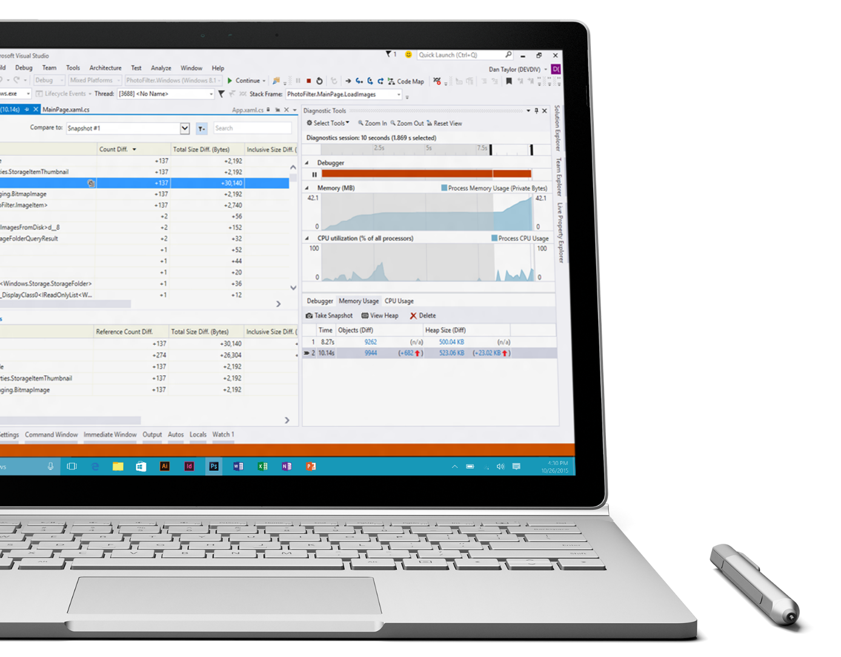
Visual Studio momentum
12.7M+ Visual Studio 2015 downloads
6K+ extensions in gallery
950K+ extension downloads per month

Slide 96
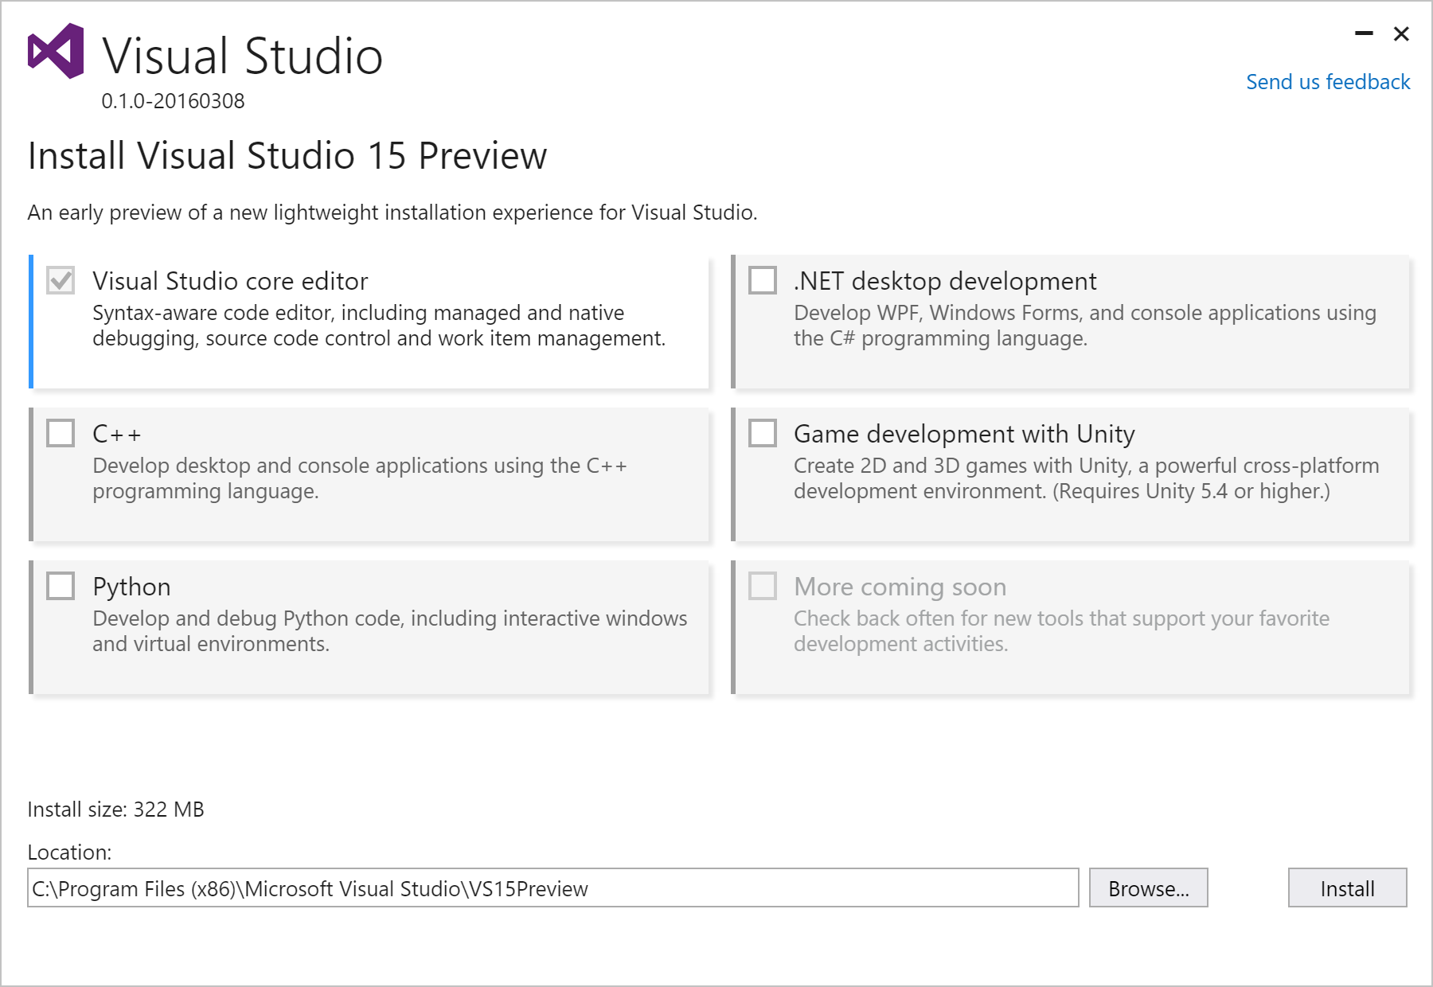
New acquisition experience
Lightweight
Base install 250 MB
Fast
Base install average <180s
Optimized
Installs only what you need
Low impact & isolated
No more MSI and GAC
http://aka.ms/vsnext

Slide 97
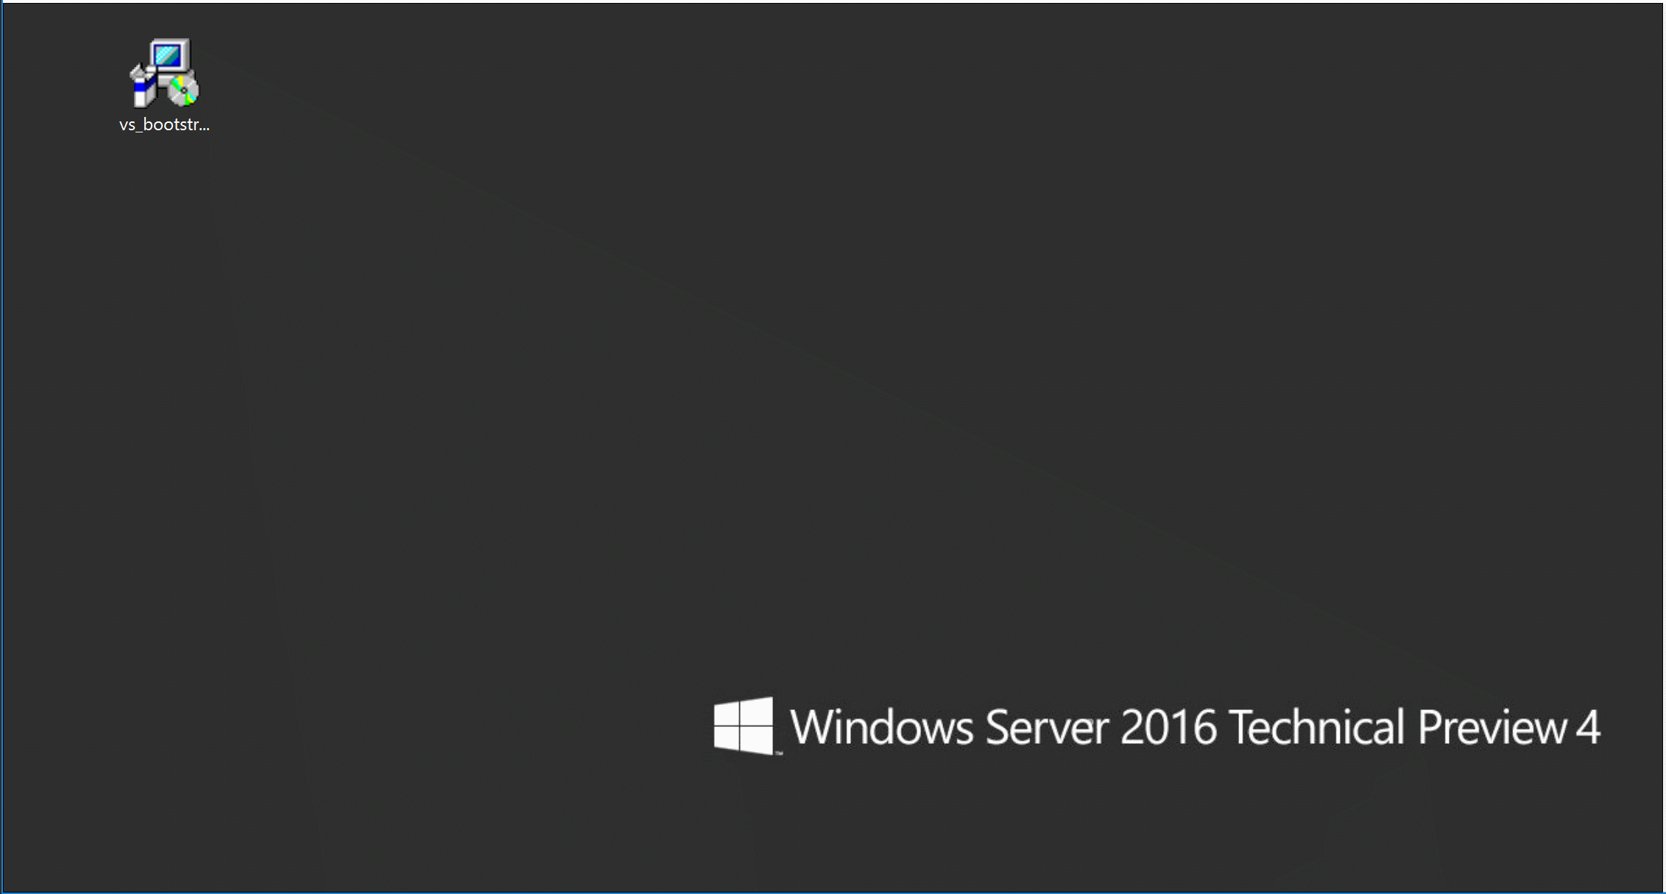

Slide 98


Tools and services for any developer, any app
Windows
Linux
iOS
Android
.NET
C++
JavaScript
PHP
Python
Node.js
R
Cordova
Unity

Slide 99
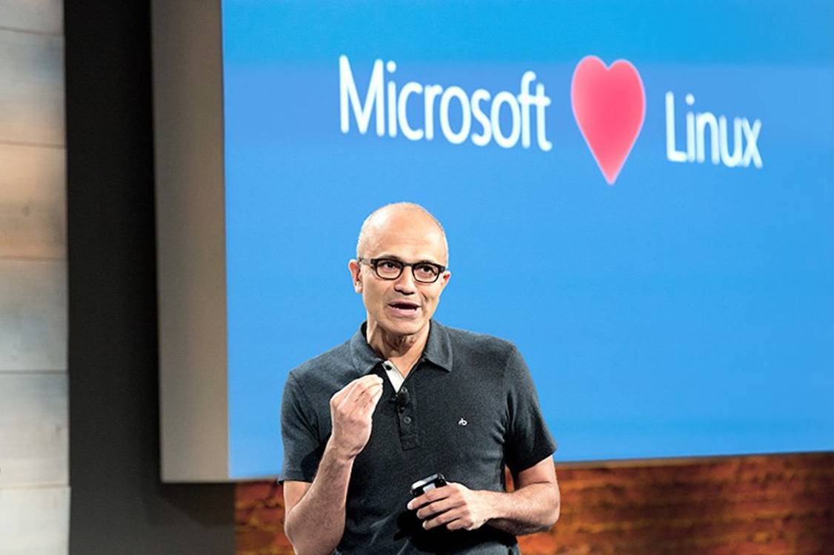

Slide 100

Developer Inner Loop Productivity
Edit
Create and update your code
Diagnose
Fix and optimize your code
Compile
Build your code
Test
Validate your code

Slide 101
Developer Inner Loop Productivity
Edit
Create and update your code
Diagnose
Fix and optimize your code
Commit
Share your code
Compile
Build your code
Test
Validate your code

Slide 102
Developer Inner Loop Productivity
Edit
More efficient in writing code
Diagnose
Performance insights and powerful debugging
Commit
Optimized SCC workflow with rich history
Compile
No time wasted waiting for compilation
Test
Quality early and continuous execution

Slide 103
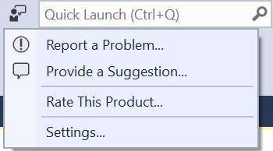
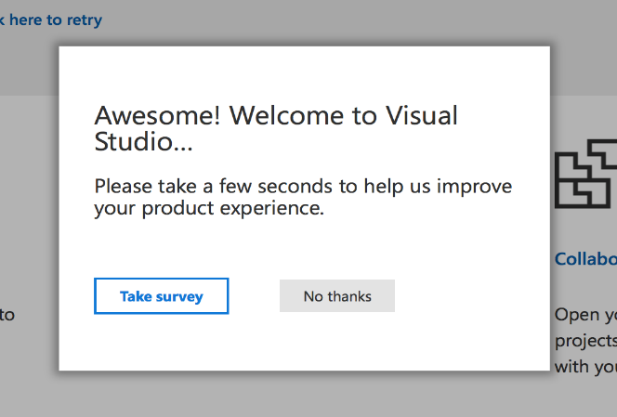
We want to hear from you!
Inside Visual Studio
Outside Visual Studio
Report a problem
“I ran into an issue”
Send a suggestion
“I have a great idea”
Rate this product
“I love Visual Studio!”
Take surveys
“I have more to tell you”
Forums
Social channels
@visualstudio

Slide 104
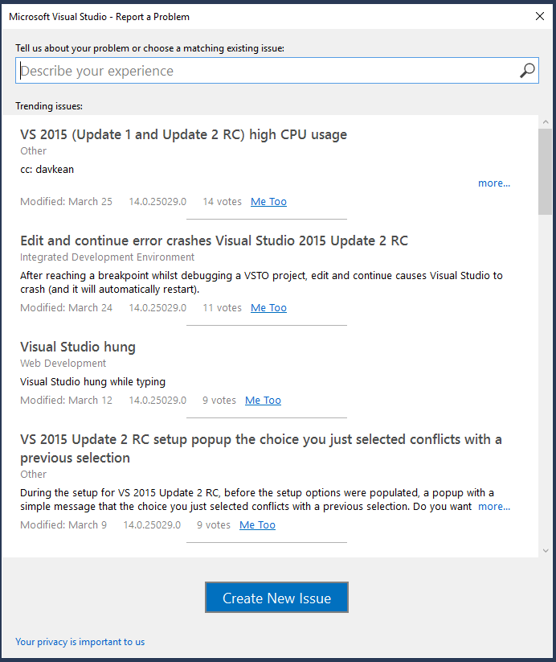
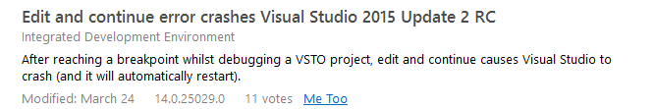
We want to hear from you!

Slide 105
Future of Visual Studio
Lightweight install, optimized for your dev needs
Any Developer, Any App
Most productive tooling in the industry
Always improving with your feedback

Slide 106
Bibliografia
http://asizikov.github.io/2016/04/02/csharp-seven-preview/
https://channel9.msdn.com/Events/Build/2016/P488
https://channel9.msdn.com/Events/Build/2016/B889
https://channel9.msdn.com/Events/Build/2016/B891
https://channel9.msdn.com/Events/Build/2016/B859
https://channel9.msdn.com/Events/Build/2016/P504
https://channel9.msdn.com/Events/Build/2016/B829
https://channel9.msdn.com/Events/Build/2016/B836
https://blog.cdemi.io/exploring-visual-studio-15-preview-and-playing-with-c-7/
https://www.infoq.com/news/2015/04/CSharp-7-Tuples
https://github.com/dotnet/roslyn/issues/2136
https://www.kenneth-truyers.net/2016/01/20/new-features-in-c-sharp-7/

